Slide 1

Capstone Project - AIML Online Batch 2020-2021 Automatic Ticket Assignment
Prepared By:
Krishnaveni Subramoniam
Rajalakshmi Raveendran
Supervised by: Saurav Karmakar
Akshay Kumar Shivangi Jain

Slide 2
Problem Statement:
In most of the IT organizations, the assignment of incidents to appropriate IT groups is still a manual process which is time consuming and requires human efforts. That leads to human errors and resource consumption. And, on the other hand, manual assignment increases the response and resolution times which result in user satisfaction deterioration / poor customer service.
Solution:
This capstone project intends to reduce the manual intervention of IT operations/Service desk teams by automating the ticket assignment process .
Goal:
The goal here is to create a text classification based ML model that can automatically classify any new tickets by analysing its description to one of the relevant Assignment groups, which could be later integrated to any ITSM tool like Service Now Based on the ticket description.
Our model will output the probability of assigning it to one of the 74 Groups.

Slide 3
Tools & Technology:
Exploratory Data Analysis
Machine learning
Deep Learning
Natural Language Processing
Dimensionality Reduction Techniques
Libraries:
Numpy, Pandas, Seaborn, Matplotlib, Scikit learn, NLTK, Tensorflow, Keras, Langdetect, Googletrans.
Algorithms:
Logistic Regression, SVM, Multinomial NB, Randomforest classifier, XGBoost.

Slide 4
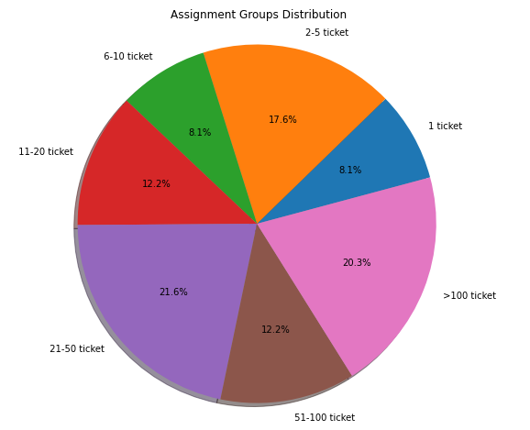
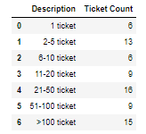
Distribution of tickets in dataset based on assignment groups
Details about the data and dataset files are from the below link:
https://drive.google.com/open?id=1OZNJm81JXucV3HmZroMq6qCT2m7ez7IJ

Slide 5
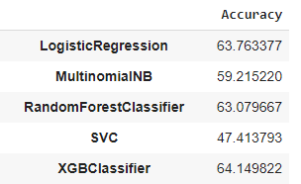
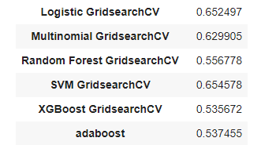
Benchmark model:
We have used the traditional Machine Learning Classification Models Logistic Regression, Multinomial NB, Random Forest, SVC and XGBoost Classifier whose accuracy is as below in Fig.1.
Fig.1 Fig.2
From the above Fig.1 the accuracy we got is seen less and Hence, we proceed with hyper-tuning of the data for a better accuracy as in Fig.2.
Inference:
After hyper parameter tuning though, we are get less accuracy due to imbalanced dataset, we use the Random oversampling technique.

Slide 6
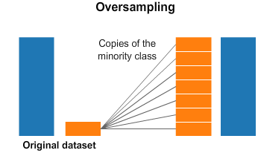
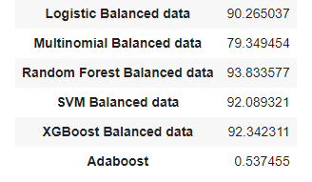
Handling Class imbalance:
Random oversampling involves randomly selecting examples from the minority class, with replacement and adding them to the training dataset.
Below are the accuracies we have got after using random oversampling technique.
Where, we can see the accuracies improved drastically after handling imbalance. Thus, we are able to achieve 93.8% accuracy for Random forest classifier and therefore we decide to take this model further in our Model.

Slide 7
Cloud Application Model Implication:
On understanding the problem statement, the major issue of existing ticket system is 25% tickets are wrongly assigned resulting in re-assigning and missing SLA. Therefore, additional effort is applied to re-assigning the ticket.
Thus, to cater this problem with the help of ML/AI-Natural language processing, the existing ticket assignment data is pre-processed by exploratory data analysis where Regex, Text cleaning, Word computation and NLP techniques are applied to construct the models that can accurately predict re-assigning of tickets. For example: Fast-text, Bidirectional LSTM, Naïve Bayes, SVM and Random Forest.
On the basis of better precision, recall and accuracy the two model’s Bidirectional LSTM and Fast-Text are used to further improve the Accuracy by applying hyper parameter tuning that finally shows the accuracy for Bidirectional LSTM as 96.5 % and Fast-Text as 90.4 %.
Therefore, Our Automatic Ticket Assignment system has error rate of less than 5 % which is far the less compared to the existing error rate of 25%.
Thus, the level of confidence is 96.5 % and the model eradicates manual intervention of assigning the tickets to respective groups.

Slide 8
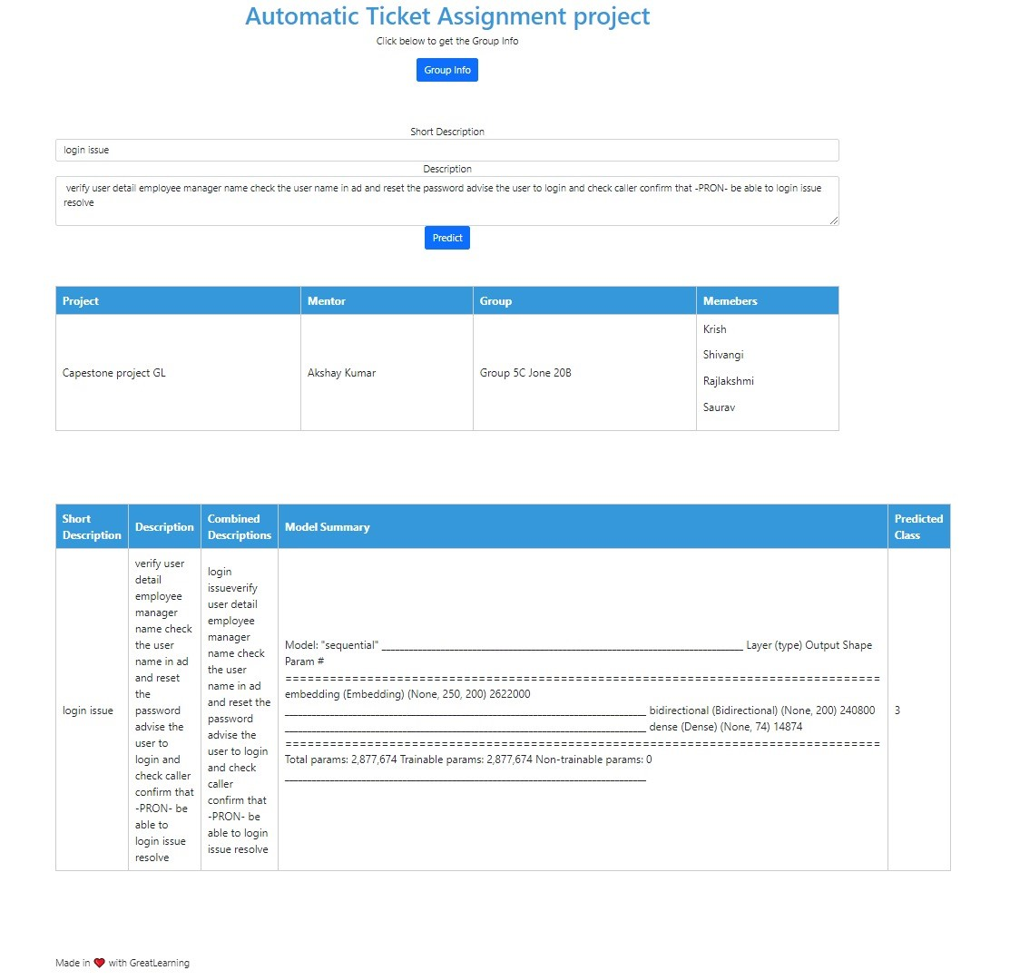
Automatic Ticket Assignment UI:

Slide 9
Learning Reflections:
Working on the problem statement, we learned:
Understanding the data its distribution and type.
Pre-processing of data and its Exploratory analysis.
Text cleaning and translation.
Visualizing the data.
Semantic analysis.
Word cloud.
Implementing models like Fast text, LSTM, SVM, Naïve Bayes, Random Forest.
Hyper parameter tuning.
Feature engineering.
Future Scope:
Executing model on balanced data and large dataset.
Executing model on multiple language dataset.
Experimenting with different models like BERT.

Slide 10
Questions ?
Thank You
References:
Application : https://github.com/SauravKarmakar/CapstoneProjectGL/tree/main/application

